Slide 1
Lecture 2: Prediction, effect sizes
Peter van der Heijden
Professor of statistics for social and behavioural sciences,
Methods and Statistics, UU

Slide 2
Outline
1. Linear regression
- Confidence interval for mean value of y
- Confidence interval for individual predictions of y
2. Classification by logistic regression
- Introduction
- Confidence interval for
3. Effect sizes
logit(π [x₀])

Slide 3
Example: GNP predicting male life expectancy
MLE vs GNP not linear
Fitting straight line not good idea
We take log
Often good idea with financial data, data more normally distributed

Slide 4
Straight line appears to be OK -> linear regression

Slide 5
male life expectancy = 25.5 + 4.8 × log(GNP)

Slide 6
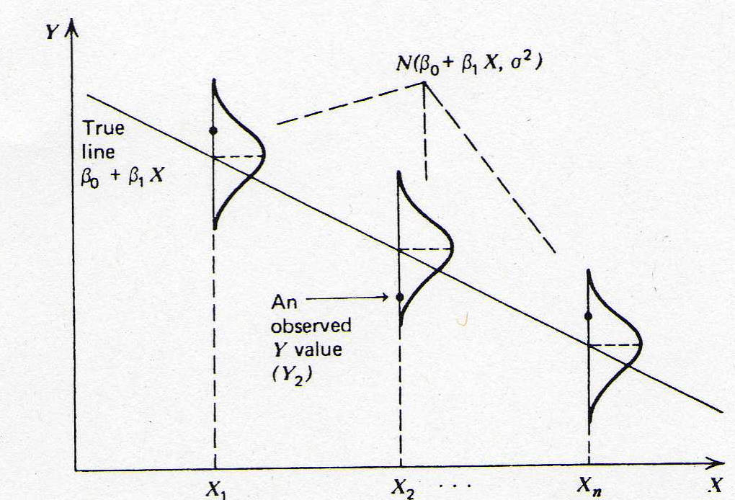
Model assumptions:
Linearity of relation
Observed y normally distributed around regression line
Normal distribution constant over regression line
Independent observations

Slide 7
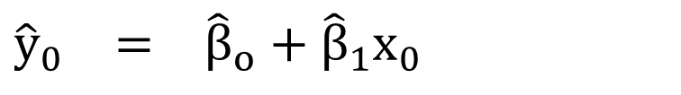
$${\hat{y}}_{0} = {\hat{β}}_{o}+{\hat{β}}_{1}x_{0}$$
So we want to find
i.e. estimates for β₀, β₁ , their standard errors and σ,
σ estimated using departures from regression line

Slide 8
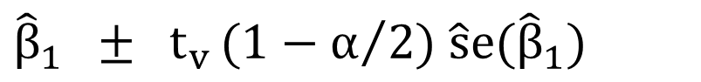
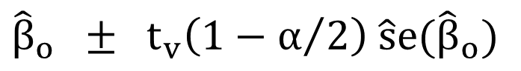
Confidence Intervals for β₀ and β₁
The confidence intervals for β₀ and β₁ at the (1 - α)% confidence level and using the t-distribution are
where t_{v}(1- α/2) is the upper quantile of the t-distribution with v = n - 2 degrees of freedom.
$${\hat{β}}_{o} ± {\text{t}}_{v}\left({1−α}/2\right) \hat{\text{s}}e({\hat{β}}_{o})$$
$${\hat{β}}_{1} ± {\text{t}}_{v}{(1−α}/2) \hat{\text{s}}e({\hat{β}}_{1})$$

Slide 9
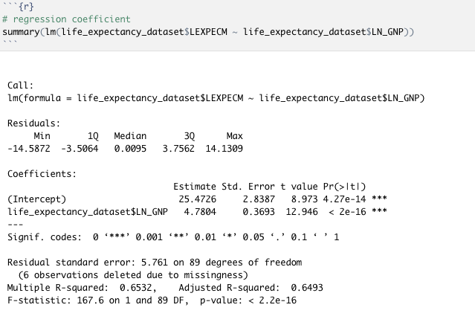
Example: Life Expectancy

Slide 10
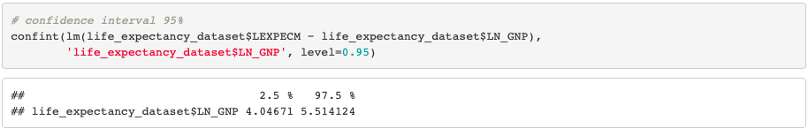
Example: Life Expectancy
95% CI for β₁: 4.780 ± 1.987 × 0.369 = (4.05, 5.51)
95% CI for β₀: 25.473 ± 1.987 × 2.839 = (19.83, 31.11)
t_{89, 0.025} = 1.987

Slide 11
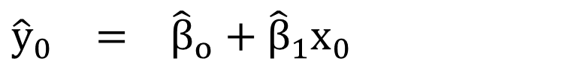
Confidence Interval for Mean Value of y
Best estimate of mean y value at a specific value x = x₀ is obtained by using the prediction from the fitted regression line
$${\hat{y}}_{0} = {\hat{β}}_{o}+{\hat{β}}_{1}x_{0}$$

Slide 12
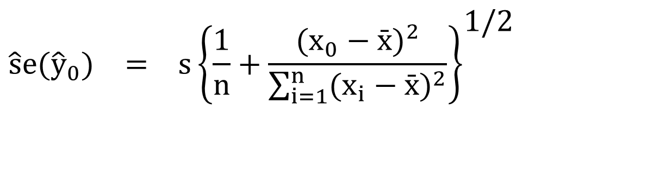
The estimated standard error is
Note the greater the distance x₀ from mean, the larger the error, i.e. best predictions in the ‘middle’ of the range and worse predictions at the ‘ends’.
Predictions become worse the further away from the observed range of x.
$$\hat{s}e({\hat{y}}_{0}) = s{\left\{\frac{1}{n}+\frac{(x_{0}−\bar{x})^{2}}{\sum_{i=1}^{n}{(x_{i}−\bar{x})^{2}}}\right\}}^{\text{1/2}}$$

Slide 13
So, the 100(1-α)% confidence interval for the mean value of y when x = x₀ is
$$({\hat{β}}_{0}+{\hat{β}}_{1}x_{0}) ± {\text{t}}_{n−2}(1−\text{α}\text{/2})×\hat{s}e({\hat{y}}_{0})$$

Slide 14
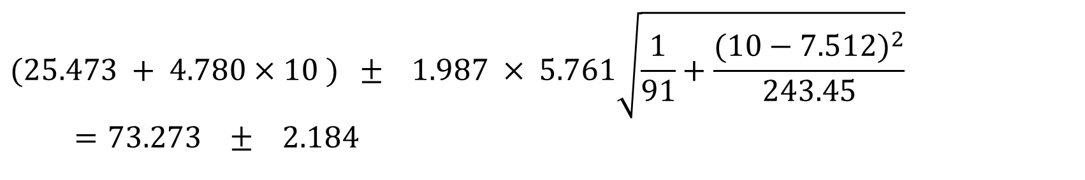
Example: Life Expectancy
So a 95% CI for the mean life expectancy of countries with log(GNP) = 10 is
= (71.09, 75.46).
Note: R calculates the estimated standard error for the predicted mean y value and the CI at every observed value of x in your dataset.
$$(\text{25.473 }+\text{ 4.780}×\text{10 }) ±\text{ 1.987 }×\text{ 5.761}\sqrt{\frac{1}{\text{91}}+\frac{(10−7.512)^{2}}{243.45}} \\ =73.273 ± 2.184$$

Slide 15
For Log GNP = 10,
CI of mean is (71.09, 75.46).
male life expectancy = 25.5 + 4.8 × log(GNP)

Slide 16
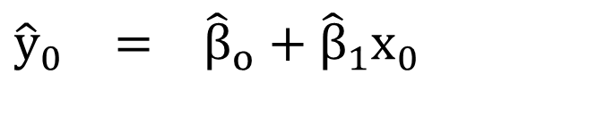
Prediction: Individual Values of y
We can also predict a future or unknown value of y given x = x₀ and construct an interval for this prediction. The predicted value is again given by
$${\hat{y}}_{0} = {\hat{β}}_{o}+{\hat{β}}_{1}x_{0}$$

Slide 17
But, the interval is not the same as that for the mean of y at x₀ since a future value of y is assumed to be normally distributed about the line and so the extra variation about the line must be taken into account.

Slide 18
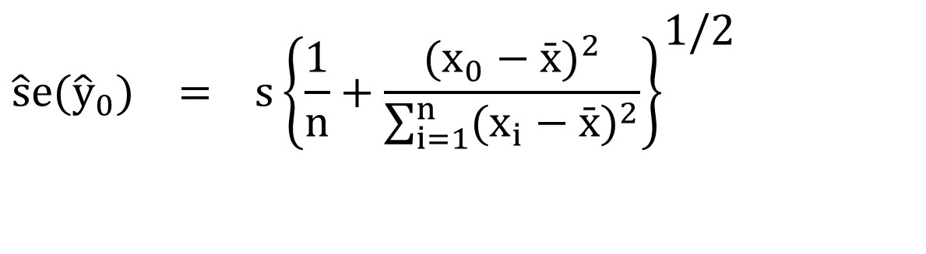
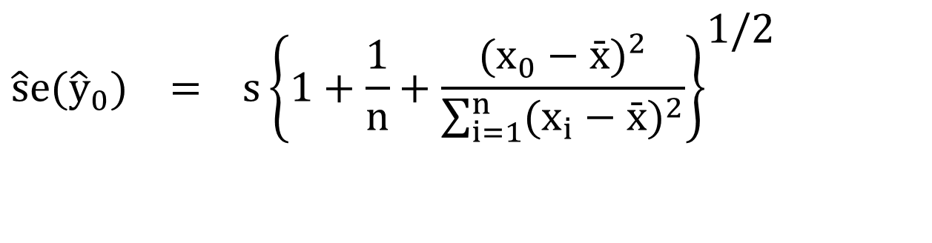
The estimated standard error for mean
The estimated standard error for individual prediction is
$$\hat{s}e({\hat{y}}_{0}) = s{\left\{\frac{1}{n}+\frac{(x_{0}−\bar{x})^{2}}{\sum_{i=1}^{n}{(x_{i}−\bar{x})^{2}}}\right\}}^{\text{1/2}}$$
$$\hat{s}e({\hat{y}}_{0}) = s{\left\{1+\frac{1}{n}+\frac{(x_{0}−\bar{x})^{2}}{\sum_{i=1}^{n}{(x_{i}−\bar{x})^{2}}}\right\}}^{\text{1/2}}$$

Slide 19
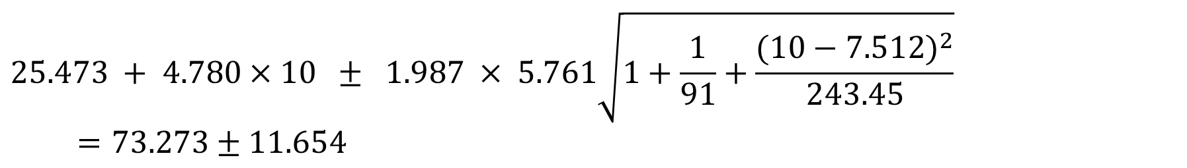
Example: Life Expectancy
A 95% CI for the life expectancy of a particular country with log(GNP) = 10 is
= (61.62, 84.93).
Compare this with (71.09, 75.46) for the mean value at log(GNP) = 10.
$$\text{25.473 }+\text{ 4.780}×\text{10 }±\text{ 1.987 }×\text{ 5.761}\sqrt{1+\frac{1}{\text{91}}+\frac{(10−7.512)^{2}}{243.45}} \\ =73.273±11.654$$

Slide 20
For Log GNP = 10,
CI of mean is (71.09, 75.46),
CI of individual prediction is (61.62, 84.93).
male life expectancy = 25.5 + 4.8 × log(GNP)

Slide 21
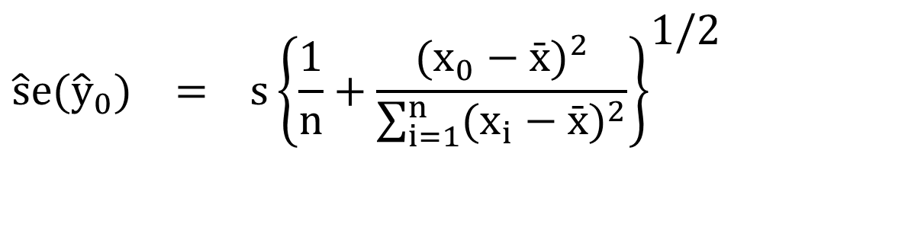
Conclusions of 1:
There is a difference between CI for predicted mean and CI for predicted individual value,
Where the latter is much larger,
And with larger n, CI for predicted mean vanishes as
CI depends on distance x-value from mean of x
The further away from the mean, the larger the CI’s,
As regression line wiggles more at extremes
Do not use regression line to predict outside range of x’s
$$\hat{s}e({\hat{y}}_{0}) = s{\left\{\frac{1}{n}+\frac{(x_{0}−\bar{x})^{2}}{\sum_{i=1}^{n}{(x_{i}−\bar{x})^{2}}}\right\}}^{\text{1/2}}$$

Slide 22
2. Classification by logistic regression
Introduction
Parameter interpretation
Classification
Prediction

Slide 23
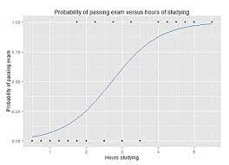
Introduction
Predict dichotomous outcome
Non-linear function to predict probability of success

Slide 24
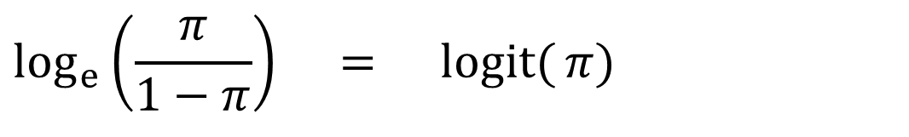
Three equivalent ways to formulate logistic regression
(1) Linear model for logit scale
$$\log_{e}\left(\frac{π}{1−π}\right) = \operatorname{logit}{(}π)$$
$$= β_{0}+β_{1}X_{1}+β_{2}X_{2}+...+β_{k}X_{k}$$

Slide 25
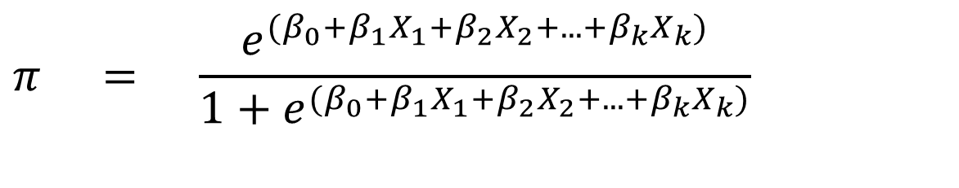
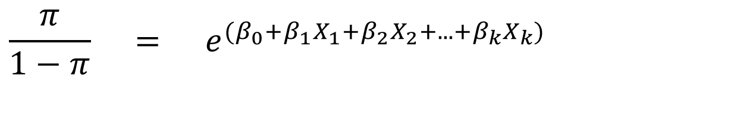
(2) Model for odds
$$\frac{π}{1−π} = e^{(β_{0}+β_{1}X_{1}+β_{2}X_{2}+...+β_{k}X_{k})}$$
(3) Model for probability
$$π = \frac{e^{(β_{0}+β_{1}X_{1}+β_{2}X_{2}+...+β_{k}X_{k})}}{1+e^{(β_{0}+β_{1}X_{1}+β_{2}X_{2}+...+β_{k}X_{k})}}$$

Slide 26
Example : Birth weight
Is the probability of a normal birth weight, as opposed to a low birth weight related to gestational age of the human foetus (number of weeks from conception to birth)?
Dependent variable is BWGHT, coded 1 = normal ; 0 = low
Independent variable (continuous) is GAGE
Data for 24 babies (7 of whom were classified as having low weight at birth).

Slide 27
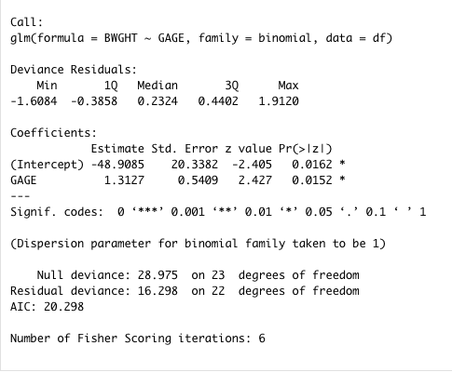
Model with GAGE
R output
Our fitted regression model is

Slide 28
Interpretation on the logit scale
A unit increase in X increases logit(p) by β₁
Birth weight
for every extra week of gestational age, the logit of the probability of a normal birth weight increase by 1.31 units, on average
OR
a unit increase in GAGE increases the log odds of normal birth weight by 1.313, on average.

Slide 29
Interpretation on the odds scale
On the odds scale:
as exp (a+b) = exp(a)exp(b). Interpret as:
A one week increase in GAGE changes the odds of normal birth weight multiplicatively by a factor equal to e^{1.31} , i.e. by 3.716.

Slide 30
Interpretation on the odds scale
Odds scale measures effects on a percentage scale.
So can interpret as the percentage change in the odds of a success for a unit change in X
A one week increase in gestational age increases the odds of a normal birth weight by

Slide 31
Interpretation on the odds scale
Percentage increase if
Percentage decrease if
Examples:
or a 172% increase in the odds of a success
or a 19% decrease in the odds of a success

Slide 32
Interpretation on the probability scale
The ‘baseline’ probability
is the probability when x equals zero.
For the birth weight example

Slide 33
Interpretation on the probability scale
The estimated probability of a baby with gestational age 39 weeks having a normal birth weight is
Baseline probability does not have a sensible interpretation for the birth weight example

Slide 34
Proportion with CHD by age
0 = low
1 = normal

Slide 35
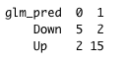
R Classification Table Summary
0 = low
1 = normal
5/7 = sensitivity
15/17 = specificity
The higher the overall %age of correct predictions (in this case 20/24 = 83%, is accuracy) the better the model.
But note, without any predictor, if we place all infants in 1, we have 17/24 = 71%

Slide 36

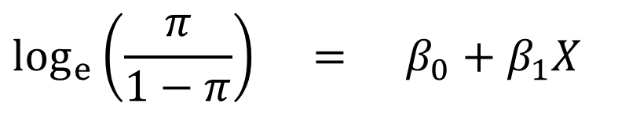
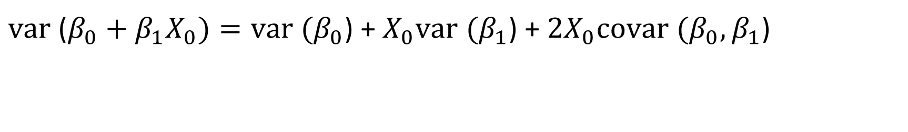
Prediction in logistic regression
Observed scores are 0, 1, predicted is probability
$$\log_{e}\left(\frac{π}{1−π}\right) = β_{0}+β_{1}X_{}$$
Variance at $X_{}$= $X_{0}$: variance of sum equals
sum of variances plus twice covariances
$var$ ($β_{0}+β_{1}X_{0})=var (β_{0}$) + $X_{0}var (β_{1}$) +${2X}_{0}covar (β_{0},β_{1}$)

Slide 37
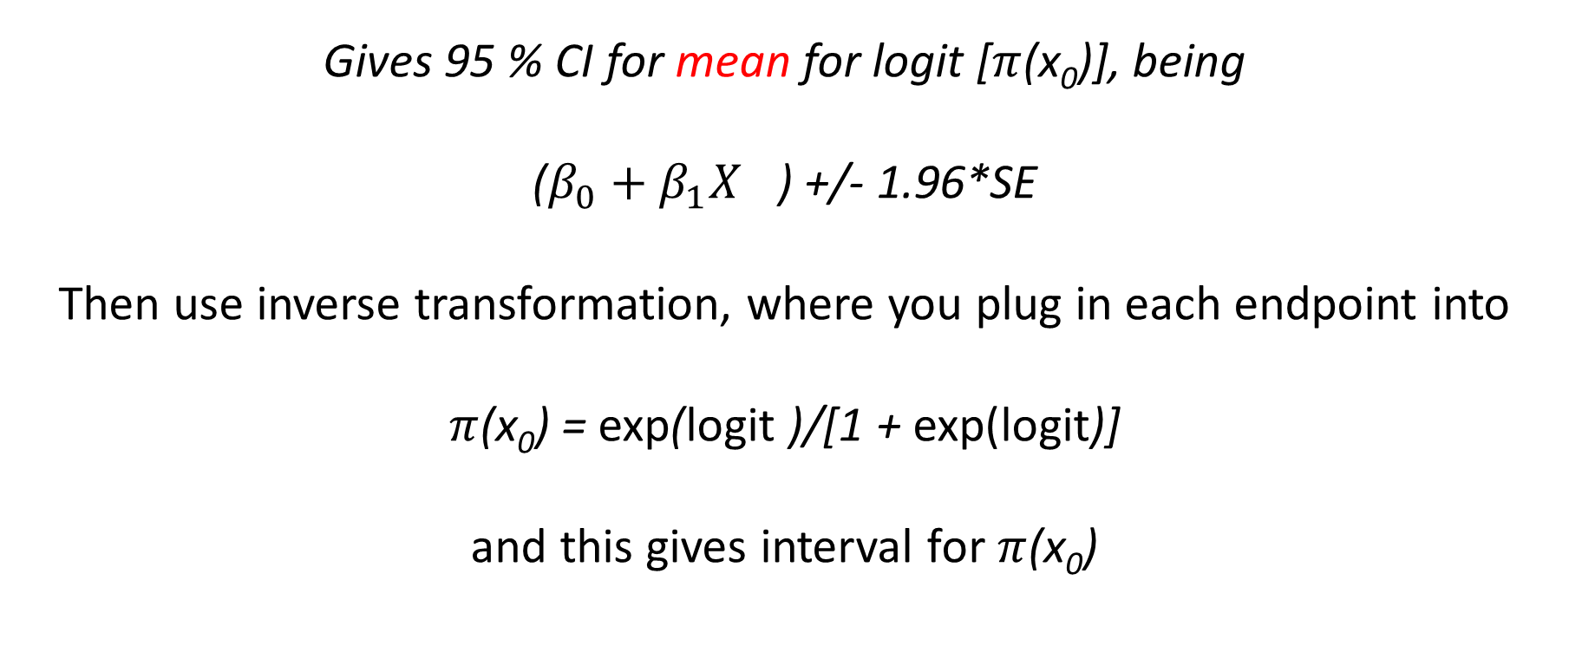
$var$ ($β_{0}+β_{1}X_{0})=var (β_{0}$) + $X_{0}var (β_{1}$) +${2X}_{0}covar (β_{0},β_{1}$)
Gives 95 % CI for mean for logit [$π$(x₀)], being ($β_{0}+β_{1}X_{}$) +/- 1.96*SE Then use inverse transformation, where you plug in each endpoint into $π$(x₀) = exp(logit )/[1 + exp(logit)]
and this gives interval for $π$(x₀)

Slide 38
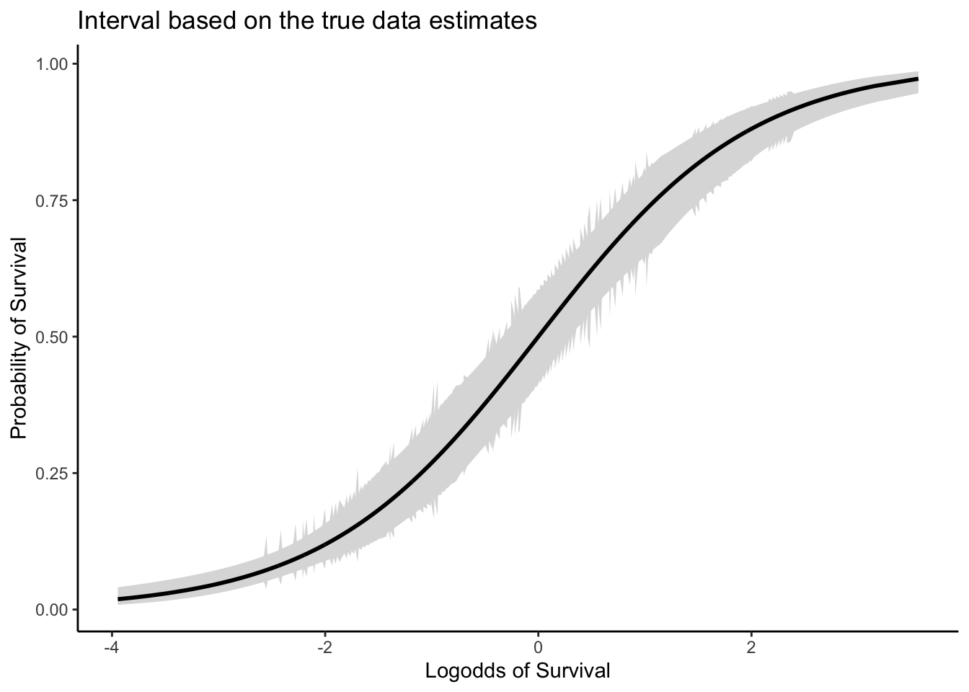
Example plot
This is for
prediction
of mean,
for prediction of
individual values,
see Workshop

Slide 39
Discussion
So we have prediction intervals for means.
How about prediction intervals for individual values?
Is this a reasonable wish, given that observed values are either 0 or 1?
I would argue it is. For predictions of individual values it may be that
Estimate of probability is .45, in CI of .35 - .60. Good to know that the cut off value of .50 is in interval.
But not everyone agrees. See Workshop for how to obtain these CI’s

Slide 40
R Classification Table Summary revisited
0 = low
1 = normal
5/7 = sensitivity
15/17 = specificity
Imagine this would have been data where classification variable is unknown, should you take into account the confidence interval for each prediction?
What is the cost of a false positive, and what is cost of false negative?
Can you postpone judgement?

Slide 41
For instance, for individual estimated probability of fraud is .40, with 95 % CI between .30 and .55.
If individual is fraud-case, then deciding no fraud policy leads to false negative
If individual is non-fraud-case, then deciding fraud policy leads to false positive.
Decision theory:
Probability mass >.50, and cost of false negative, true negative
Probability mass < .50, and cost of true positive, false positive.

Slide 42
95% CI or 99% CI? Or 90% CI?
Larger sample sizes make CI smaller, and hypotheses are easily rejected, even when they do not depart much from the nul-hypothesis
Smaller sample sizes make CI larger, and hypotheses are not easily rejected, even when departure from nul hypothesis is large. For smaller sample sizes one often takes smaller CI, for example 90 % CI

Slide 43
Conclusions of 2. Classification by logistic regression
Probabilities used for classification have a confidence interval that may or may not be taken into account
Consider errors in terms of false positives and false negatives
Is it possible to say something about costs?

Slide 44
3. Effect sizes: effect of individual variables
Generally: when equation is
then the effect size of x1 is

Slide 45
Quadratic regression
then effect size of x is
So effect of x depends on x itself!

Slide 46
The fitted quadratic regression curve is
Minimum lies outside
range of x
(do you see this?)

Slide 47
The fitted quadratic regression curve is
Minimum lies outside
range of x
Set derivative equal to 0 and calculate x

Slide 48
Effect sizes for interaction
Interaction by multiplying variables.
E[y|x] = β₀ + β₁ x₁ + β₂ x₂ + β₃ x₁ x₂
Two ways in which this can be rewritten are
E[y|x] = (β₀ + β₂ x₂ ) + (β₁ + β₃ x₂) x₁
E[y|x] = (β₀ + β₁ x₁ ) + (β₂ + β₃ x₁) x₂

Slide 49
For E[y|x] = (β₀ + β₂ x₂ ) + (β₁ + β₃ x₂) x₁
the effect size for x₁ is β₁ + β₃ x₂, i.e. a function of x₂.
Hence x₂ moderates the effect of x₁ on E[y|x].
For example: gender moderates effect of occupation mother on math score (or, which is mathematically identical: occupation mother score moderates effect of gender on math score)

Slide 50
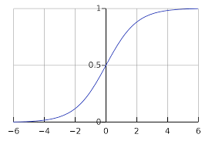
Effect size in logistic regression: marginal effects
change in Pr(y=1|x,z) due to a change in x depends on x and on all other explanatory variables z, i.e. it depends on where an individual is on the logistic curve

Slide 51
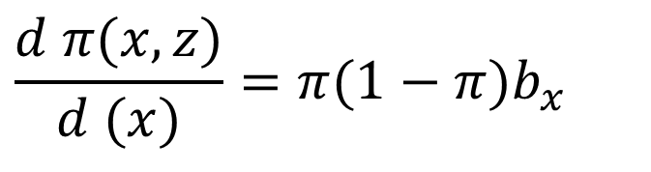
Just like in linear regression we take derivatives, here derivative of p w.r.t. x
We calculate for each observation (individual) separately the effect, and then average these effects.
$$\frac{d π(x,z)}{d (x)}=π(1−π)b_{x}$$

Slide 52
Analysis of re-employment of data of unemployed men aged 40--55.
Finding work within one year after being unemployed as a function of age, health and educational level
Work = 1: work found within one year
LOGIST REGR work WITH age health edu
/METHOD = ENTER age health edu /SAVE pred(pre).
Variables in the Equation
B S.E. Wald df Sig. Exp(B)
age -,128 ,031 17,1 1 ,000 ,879
health -,319 ,158 4,9 1 ,043 ,727
edu ,201 ,123 2,7 1 ,102 1,222
Constant 6,356 1,523 17,4 1 ,000 575,905

Slide 53
COMP d_health = pre*(1-pre)*(-.319).
COMP d_age = pre*(1-pre)*(-.128).
COMP d_edu = pre*(1-pre)*( .201).
MEANS d_age d_health d_edu.
Mean(d_age) = -0.0280
Mean(d_health) = -0.0697
So on average the effect of one year of age is 2.8% decrease in probability to find work, etc.
Useful addition to interpretational tools of logistic regression

Slide 54
Conclusions of 3. Effect sizes
Where effect sizes are trivial in standard multiple regression, they provide helpful additions to the interpretation for quadratic regression, interactions and logistic regression
In particular for logistic regression the addition is useful, as the standard interpretation of the parameter estimates in logistic regression is difficult, and the interpretation of marginal effects is easy

Slide 55
Thank you for your attention. Questions?

